Slide 1
Recommendation Systems

Slide 2
Jaccard Similarity
Jaccard Similarity = (number of observations in both sets) / (number in either set)
mathematically,
J(A, B) = |A∩B| / |A∪B|

Slide 3
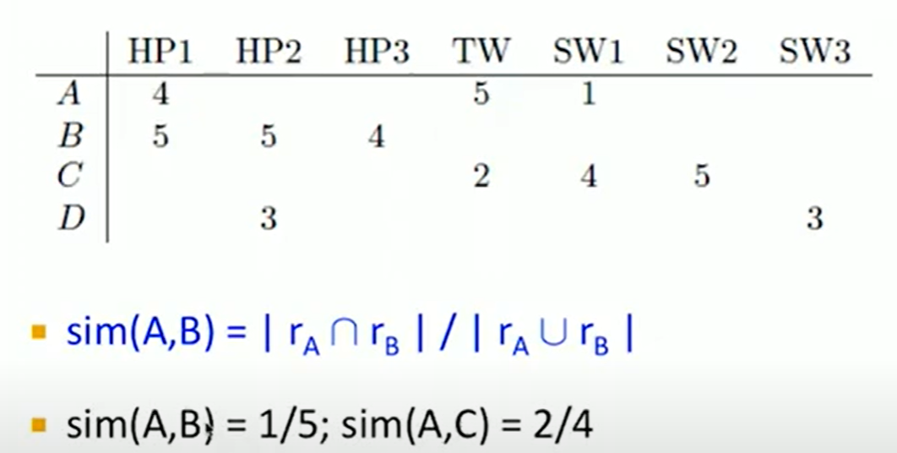
Jaccard Similarity

Slide 4
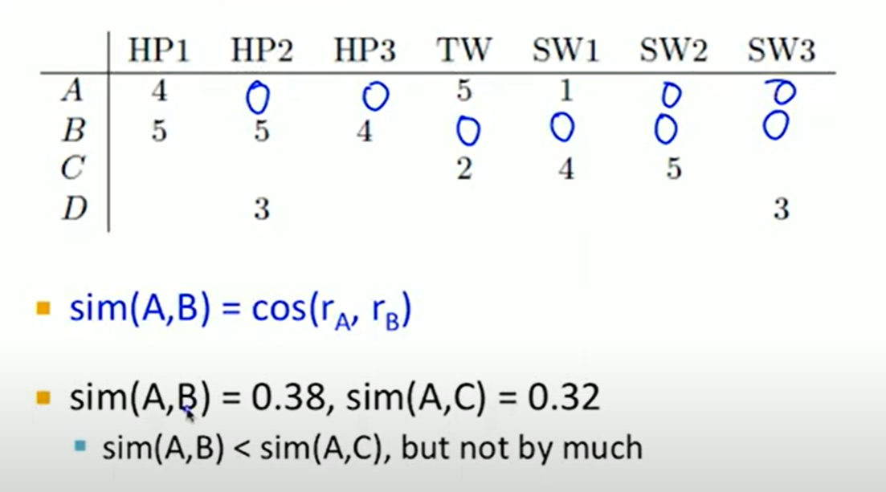
Cosine Similarity

Slide 5
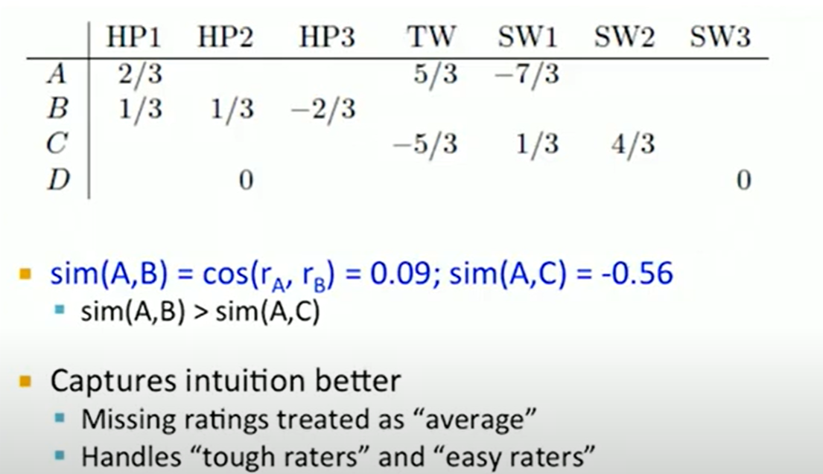
Pearson Correlation (Centered Cosine)
Normalize rating by subtracting the mean

Slide 6
Text Similarity
Text similarity refers to measuring how similar two pieces of text are, based on their content, structure, or semantic meaning.
TF-IDF:
Term Frequency (TF): Measures how often a word appears in a document.
Inverse Document Frequency (IDF): Measures how unique or rare a word is across a collection of documents.
The combination helps in weighting the words and improving the cosine similarity measure by reducing the impact of common words.

Slide 7
Cosine Similarity
Text Preprocessing:
Tokenization: Split the text into individual words or tokens.
Lowercasing: Convert all text to lowercase to ensure uniformity.
Stopword Removal: Remove common words (like "the", "and", "is") that do not contribute much to the meaning.
Stemming/Lemmatization: Reduce words to their base or root form.
Vector Representation:
Term Frequency (TF): Count the frequency of each word in the document.
Inverse Document Frequency (IDF): Calculate the importance of a word based on its rarity across multiple documents.
TF-IDF: Combine TF and IDF to get a weighted score that reflects the importance of a word in a document relative to a collection of documents.

Slide 8
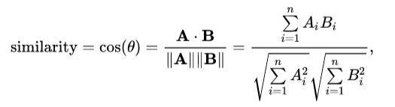
Cosine Similarity
Construct Vectors:
Represent each document as a vector of TF-IDF scores, where each dimension corresponds to a unique word in the corpus.
Calculate Cosine Similarity:
Use the cosine similarity formula to compute the similarity between two document vectors.

Slide 9
Cosine Similarity (Example)
Text A: "I love machine learning and data science."
Text B: "Data science and machine learning are fascinating."
Preprocessing:
After tokenization and stopword removal:
TextA: ["love", "machine", "learning", "data", "science"]
TextB:["data", "science", "machine", "learning", "fascinating"]
Vector Representation
Create a vocabulary:
["love", "machine", "learning", "data", "science", "fascinating"]
Calculate TF-IDF for each word in both texts.

Slide 10
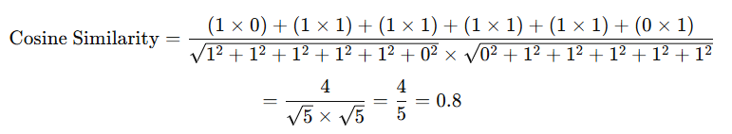
Cosine Similarity (Example)
TF-IDF Vectors:
TextA: [1, 1, 1, 1, 1, 0]
TextB: [0, 1, 1, 1, 1, 1]

Slide 11
Types of Recommendation Systems
Content-based filtering
Collaborative filtering
User-user collaborative filtering
Item-item collaborative filtering
Hybrid systems
Knowledge-based recommendations
Context-aware recommendation systems

Slide 12
Collaborative Filtering
Collaborative filtering is a popular technique in recommendation systems that predicts a user's preferences by leveraging other users' preferences.
There are two main types of collaborative filtering:
user-user collaborative filtering, and
item-item collaborative filtering.

Slide 13
User-Based Collaborative Filtering:
This approach predicts a user's rating for an item based on ratings given by other users who have similar preference
Step1: User Similarity Computation
Calculate the similarity between users using metrics like Jaccard similarity, cosine similarity, or Pearson correlation.
Step 2: Neighborhood Formation:
Identify a group of users (neighbors) who are most similar to the target user.
Step 3: Prediction
Predict the rating for an item by averaging the ratings given by similar users, possibly weighted by their similarity scores.

Slide 14
Item-Based Collaborative Filtering:
This method predicts a user's rating for an item based on the user’s previous ratings of similar items.
Example: If a user likes movie A and movie B is similar to movie A, the system can recommend movie B to the user.
Steps:
1. Item Similarity Computation
2. Neighborhood Formation:
3. Prediction

Slide 15
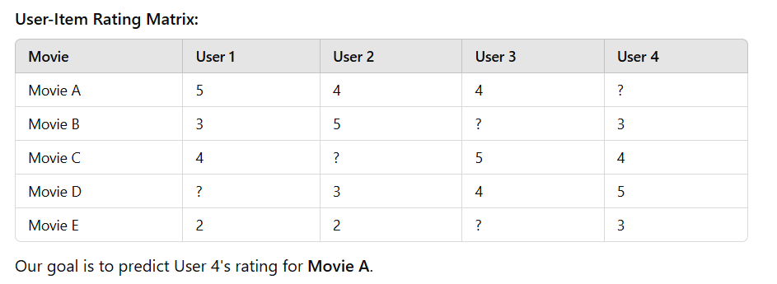
Example

Slide 16
Model-Based Collaborative Filtering:
Utilizes machine learning models to learn user-item interactions and make predictions.
Techniques:
Matrix Factorization (e.g., SVD, ALS): Decomposes the user-item matrix into latent factors representing users and items.
Deep Learning: Neural networks to capture complex user-item interactions.
Example: Netflix’s recommendation system uses matrix factorization to predict user preferences for movies.

Slide 17
Cold Start Problem
The cold start problem occurs when a recommendation system struggles to make accurate suggestions due to insufficient data about new users, new items, or both.
Types of Cold Start Problems
New User
New Item
New System

Slide 18
Cold Start Problem- Common Solutions
For New User Cold Start
Onboarding questionnaires/preference elicitation
Demographic-based recommendations
Popular items / trending courses
Hybrid systems
For New Item Cold Start
Content-based metadata
Expert curation
For New System Cold Start
Seed data
Transfer learning / Cross-domain recommendation
Advanced Techniques

